Slide 1
Principle of Operating System
Mohammed Arfat
International Islamic University Chittagong

Slide 2
What is Operating System:
An Operating System a program that acts as an interface between the user and the hardware. It is a resource allocated and provides a platform for the application programs.
An operating system acts as a bridge between user and hardware.

Slide 3
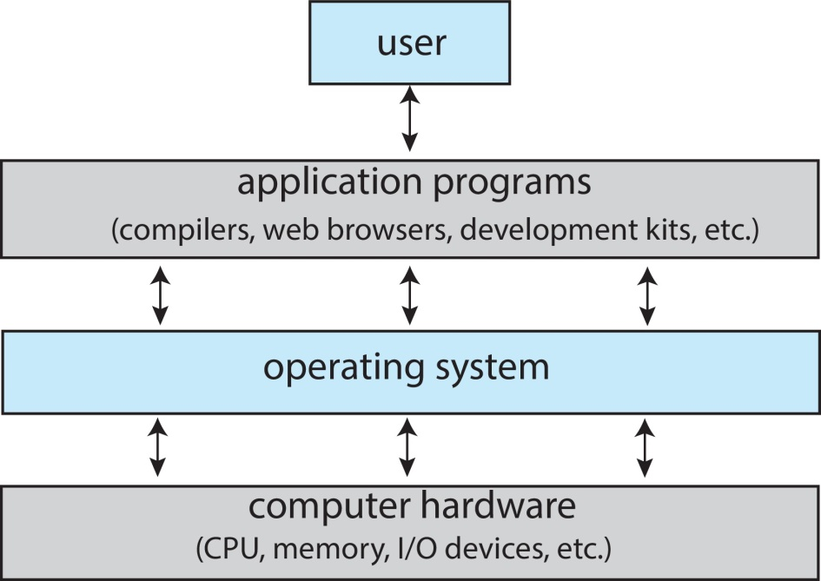

Slide 4
Computer System Structure
Computer system can be divided into four components:
Hardware – provides basic computing resources
CPU, memory, I/O devices
Operating system - Controls and coordinates use of hardware among various
applications and users
Application programs – define the ways in which the system resources are
used to solve the computing problems of the
Word processors, compilers, web browsers, database systems, video games Users
users
People, machines, other computers

Slide 5
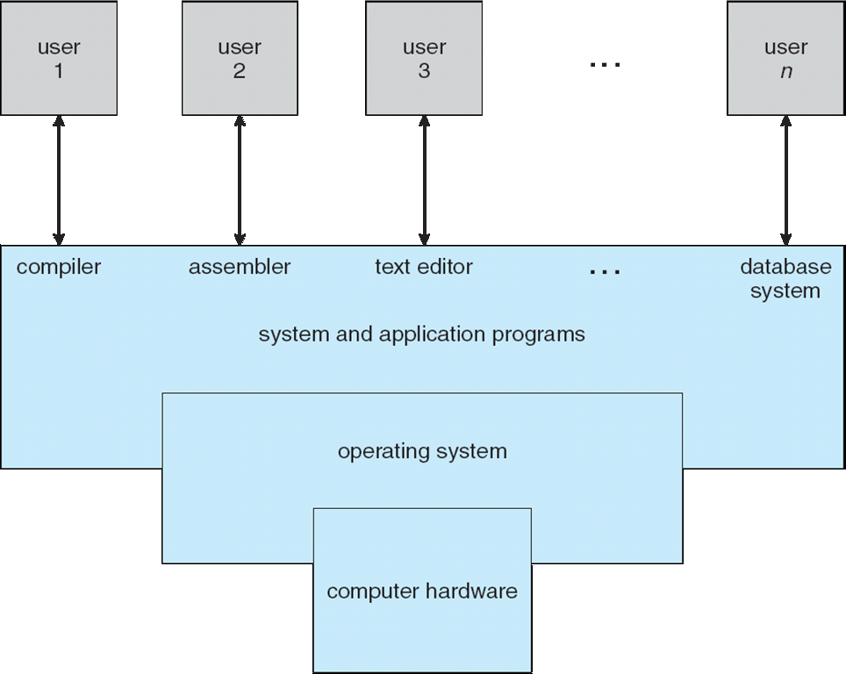

Slide 6

WHY STUDY OPERATING SYSTEMS?

Slide 7
Operating System Goals
Execute user programs and solving user problems easier
Make the computer system convenient to use
Use the computer hardware in an efficient manner

Slide 8
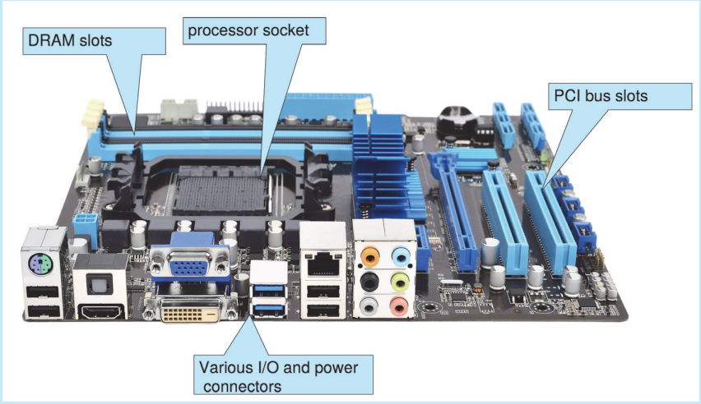

Slide 9
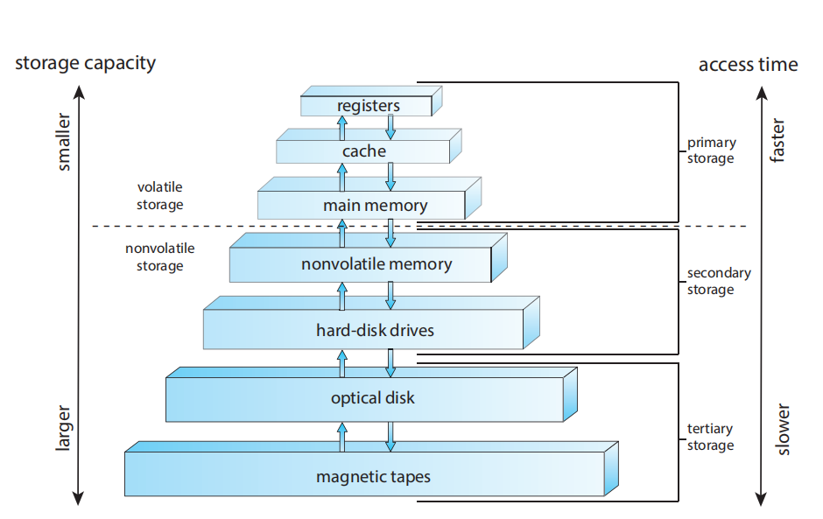
Storage-device hierarchy

Slide 10
Kernel
Kernel is central component of an operating system that manages operations of computer and hardware. It basically manages operations of memory and CPU time. It is core component of an operating system. Kernel acts as a bridge between applications and data processing performed at hardware level using inter-process communication and system calls
Job: The unit of work that a computer operator or a program called a job scheduler.

Slide 11
Operating system structure:
Simple structure
layered approach
Monolithic approach
Micro-kernels
Virtual machines.

Slide 12
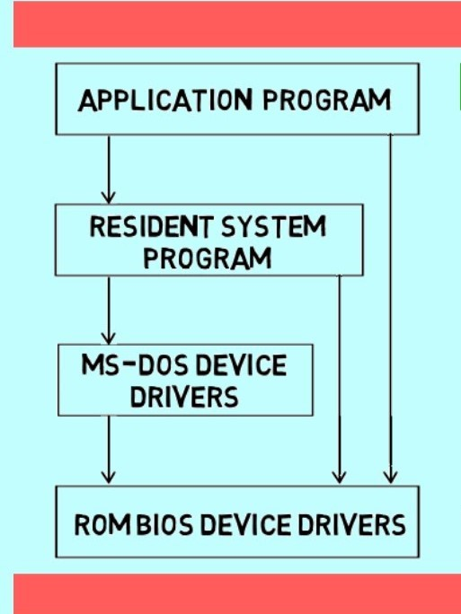
Simple structure
Followed by the Microsoft Disk OS(MS-DOS)

Slide 13
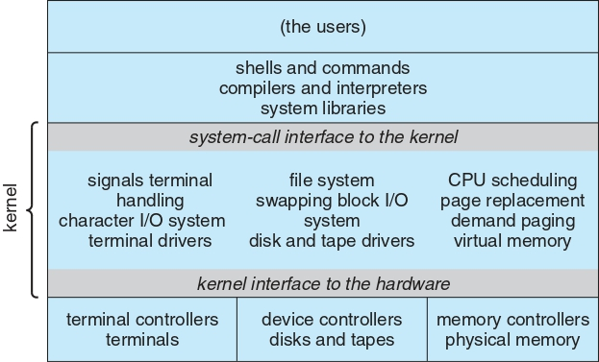
Monolithic Structure

Slide 14
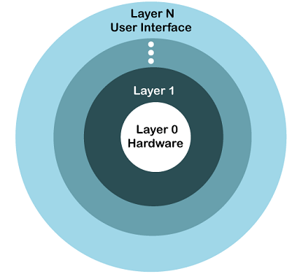
layered approach

Slide 15
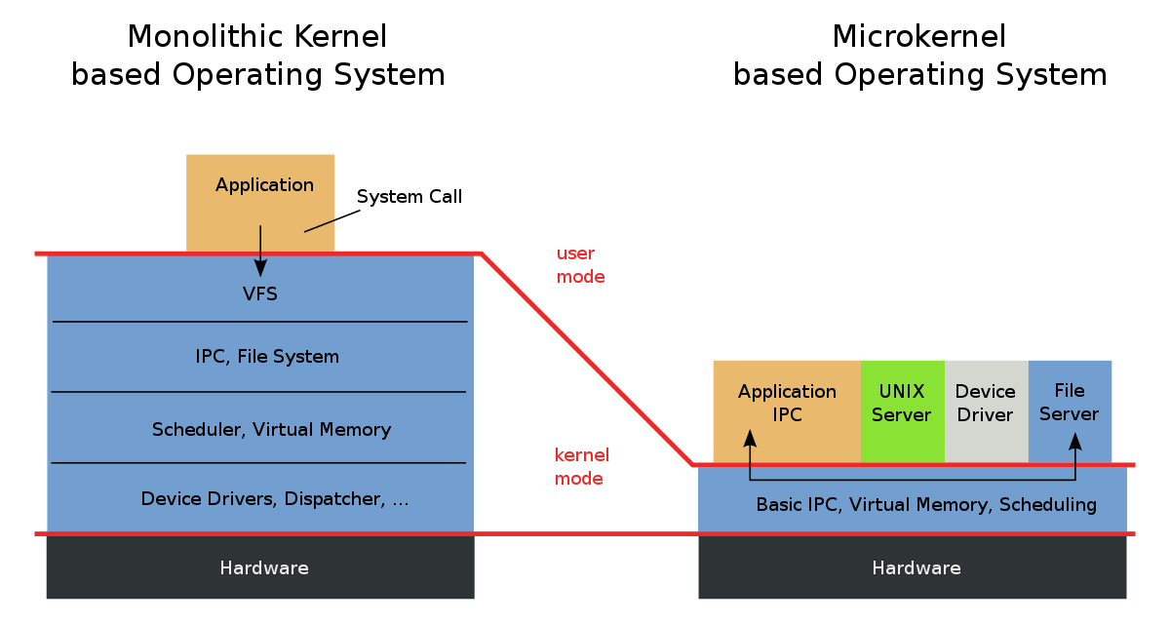

Slide 16
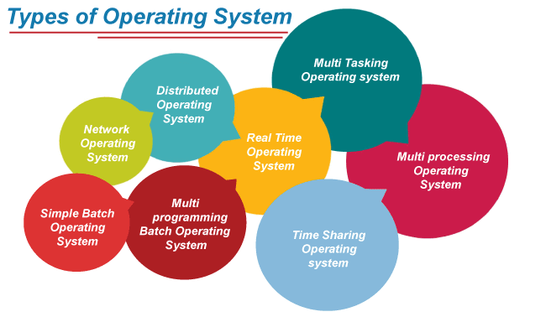

Slide 17
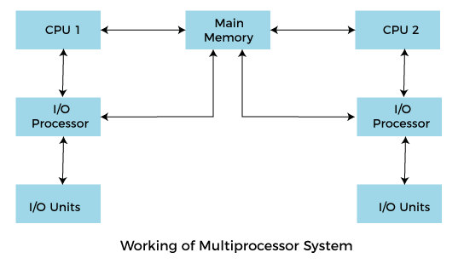
Multiprocessing Operating System
In Multiprocessing, Parallel computing is achieved. There are more than one
processors present in the system which can execute more than one process at
the same time. This will increase the throughput of the system.
For Example: UNIX Operating system is one of the most widely used multiprocessing systems.

Slide 18
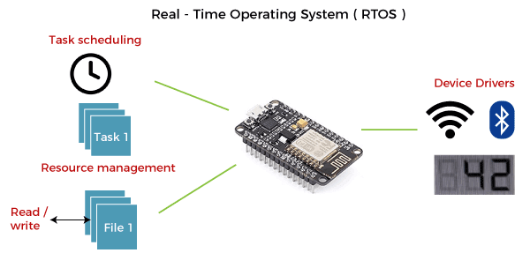
Real Time Operating System
In Real-Time Systems, each job carries a certain deadline within which
the job is supposed to be completed, otherwise, the huge loss will be
there, or even if the result is produced, it will be completely useless.

Slide 19
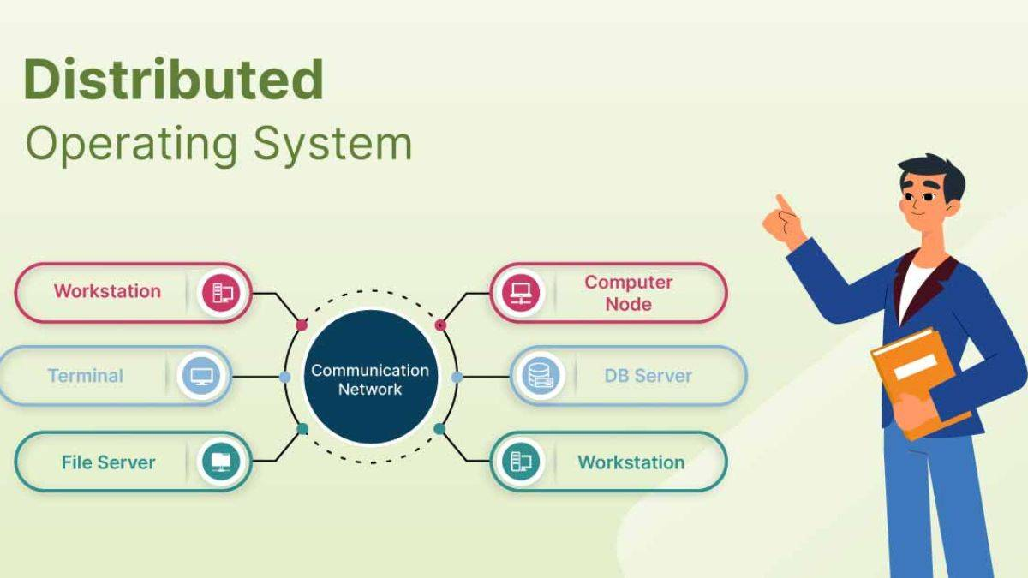
Distributed System

Slide 20
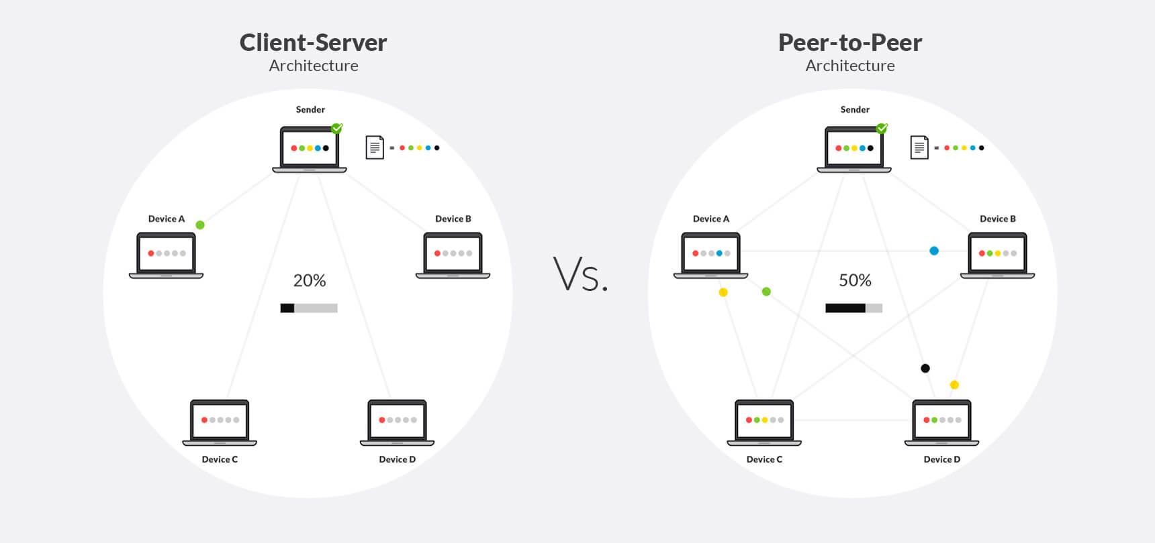
Types of Distributed Operating System
Client-Server Systems
Peer-to-Peer Systems

Slide 21
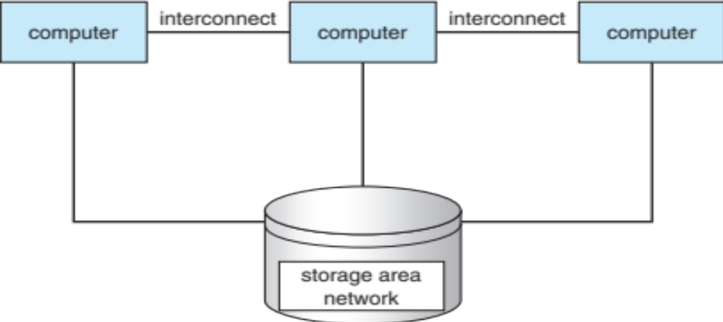
Clustered Operating System
1.Clustered system is composed of two or more individual computer system joined together
2.Share common storage and are closely linked through local area network
3.Individual computers are called nodes
4.Most cases - Hardware sharing Some times - OS sharing

Slide 22
Handheld Operating System
Handheld operating systems are present in all handheld
devices like Smartphones and tablets. It is also called a
Personal Digital Assistant. The popular handheld device in
today’s market is android and iOS.
These operating systems need a high processing processor
and also embedded with different types of sensor.

Slide 23
Services of Operating System
Input Output Operations
Program execution
File Management
Communication between Process
Security and Privacy
Resource Management
User Interface
Error handling

Slide 24
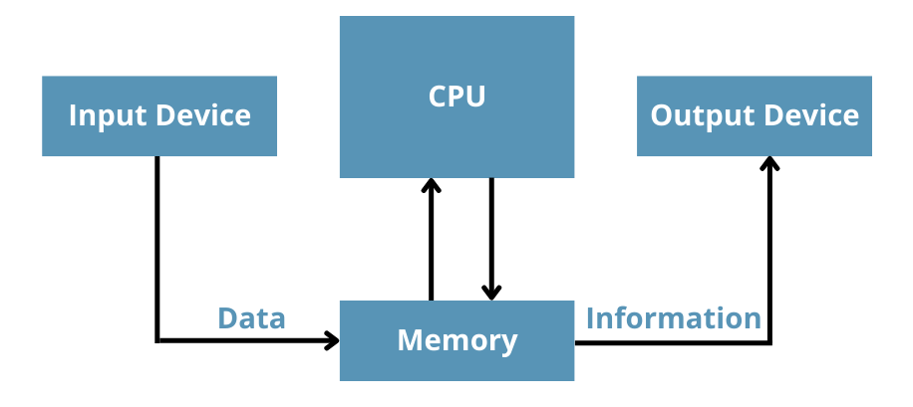
Input Output Operations

Slide 25
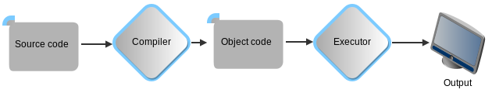
Program execution

Slide 26
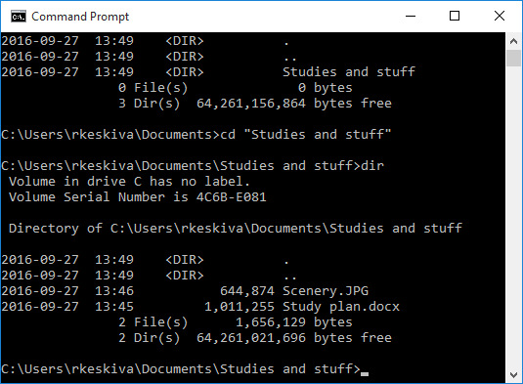
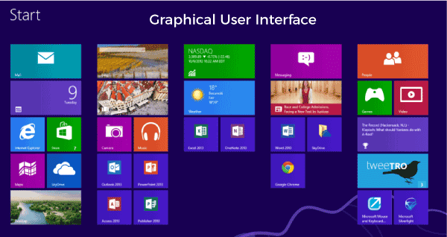
User and Operating-System Interface
1. Command line interface
2.Graphical User Interface

Slide 27
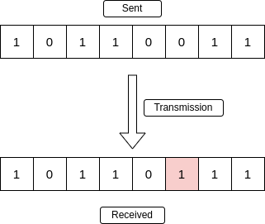
Error handling

Slide 28
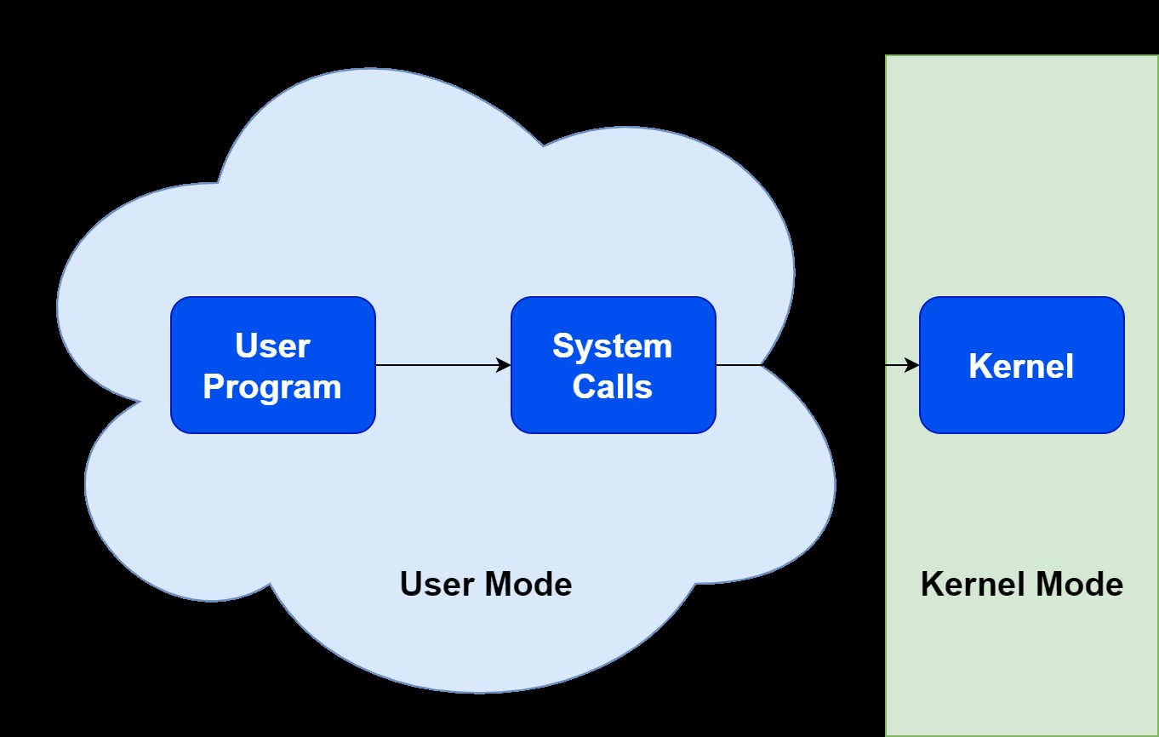
System Calls
A system call is a way for a user program to interface with the
operating system.

Slide 29
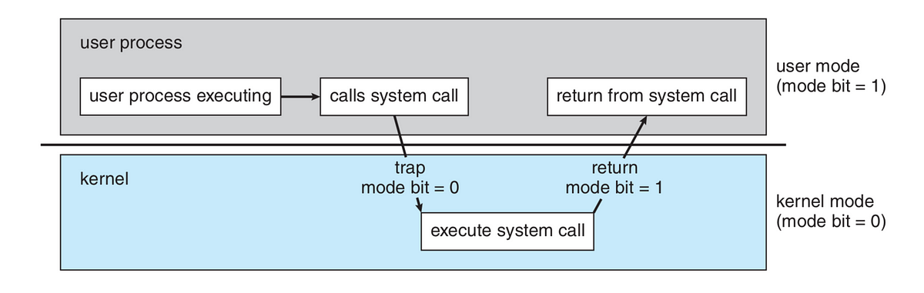
User Mode Vs Kernel Mode:

Slide 30
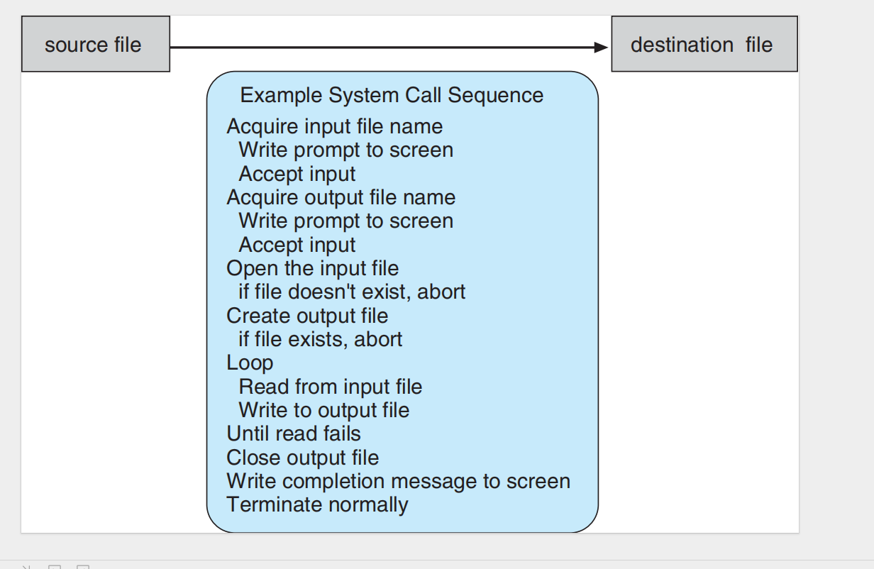
Example of how system calls are used

Slide 31
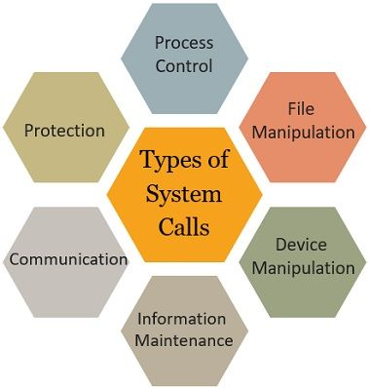
Types of System Calls

Slide 32
Process control
◦ create process, terminate process
◦ load, execute
◦ get process attributes, set process attributes
◦ wait event, signal event
◦ allocate and free memory

Slide 33
File management
◦ create file, delete file
◦ open, close
◦ read, write, reposition
◦ get file attributes, set file attributes

Slide 34
Device management
◦ request device, release device
◦ read, write, reposition
◦ get device attributes, set device attributes
◦ logically attach or detach devices

Slide 35
Information maintenance
◦ get time or date, set time or date
◦ get system data, set system data
◦ get process, file, or device attributes
◦ set process, file, or device attributes

Slide 36
Communications
◦ create, delete communication connection
◦ send, receive messages
◦ transfer status information
◦ attach or detach remote devices

Slide 37
Important System Calls Used in OS
1.wait()
In certain systems, a process must wait for another process to finish running before continuing.
2.fork()
The fork system call in OS is used by processes to make copies of themselves.
3.exec()
When an executable file replaces an earlier executable file within the context of an active process, this system call is executed
4.kill()
The OS uses the kill() system call to urge processes to terminate by sending them a signal
5.exit()
An exit system call is used when the programme must be stopped.

Slide 38
Operating System Design Goals
Design Goals:
System Goals
The operating system should be easy to design, implement and maintain. These are specifications required by those who create, maintain and operate the operating system. But there is not specific method to achieve these goals as well.
User Goals
The operating system should be convenient, easy to use, reliable, safe and fast according to the users.

Slide 39
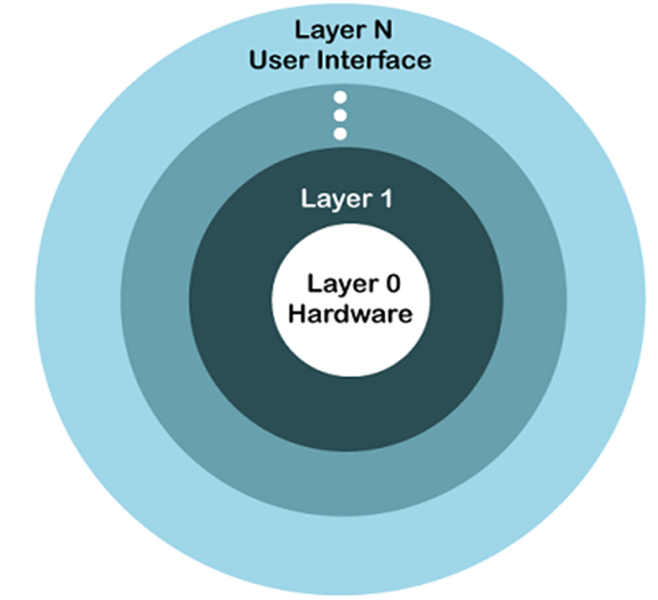
Operating System Mechanisms and Policies
Operating System Implementation
Advantages of Higher Level Language
Disadvantages of Higher Level Language

Slide 40
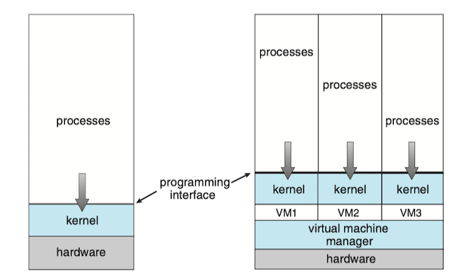
Virtual Machine:
Virtualization is a technology that allows us to abstract the hardware of a single computer (the CPU, memory, disk drives, network interface cards, and so forth) into several different execution environments, thereby creating the illusion that each separate environment is running on its own private computer.

Slide 41
Advantage of Virtual Machine:
Cost
Agility and speed Lowered downtime
Scalability
Security benefits

